Slide 1
Section 01
Introduction

Slide 2
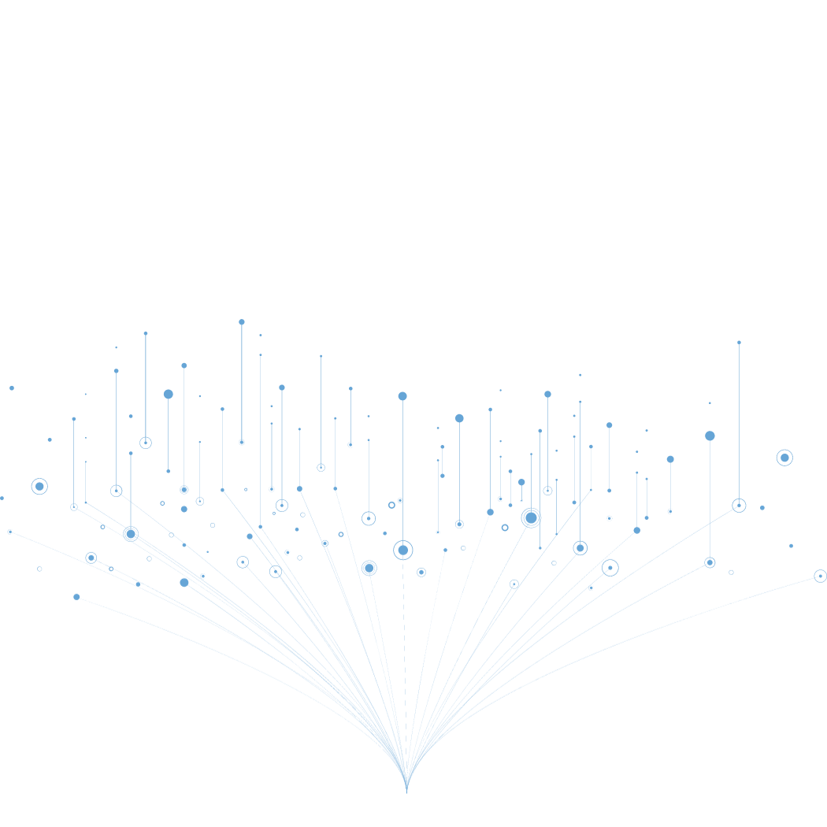
What Is A Data Lake?

Slide 3

Introduction to Data Lake
Explore fundamental concept
Foundation for modern data storage solutions
Crucial for mastering data engineering

Slide 4
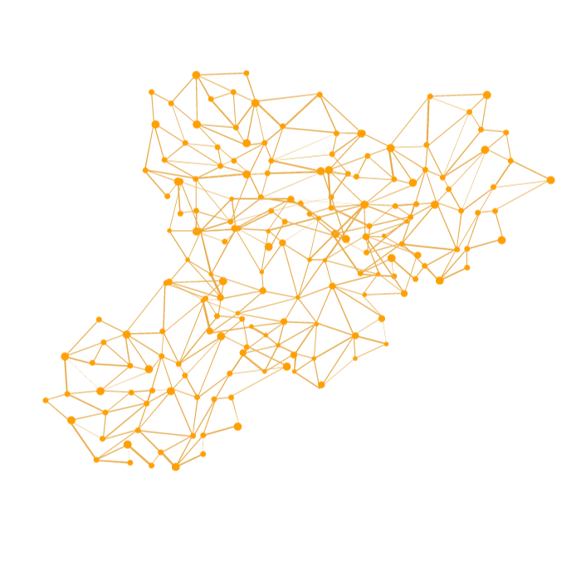

What is a Data Lake?
Vast and centralized repository
Stores structured and unstructured data
Data stored in native format

Slide 5
Evolution of Data Lakes
BIG
DATA
DATA LAKE
Roger Magoulas
(2005)
James Dixon
CTO of Pentaho
(2010)
Manage Large Data Volumes
SQL tools struggle to manage and analyze data.

Slide 6
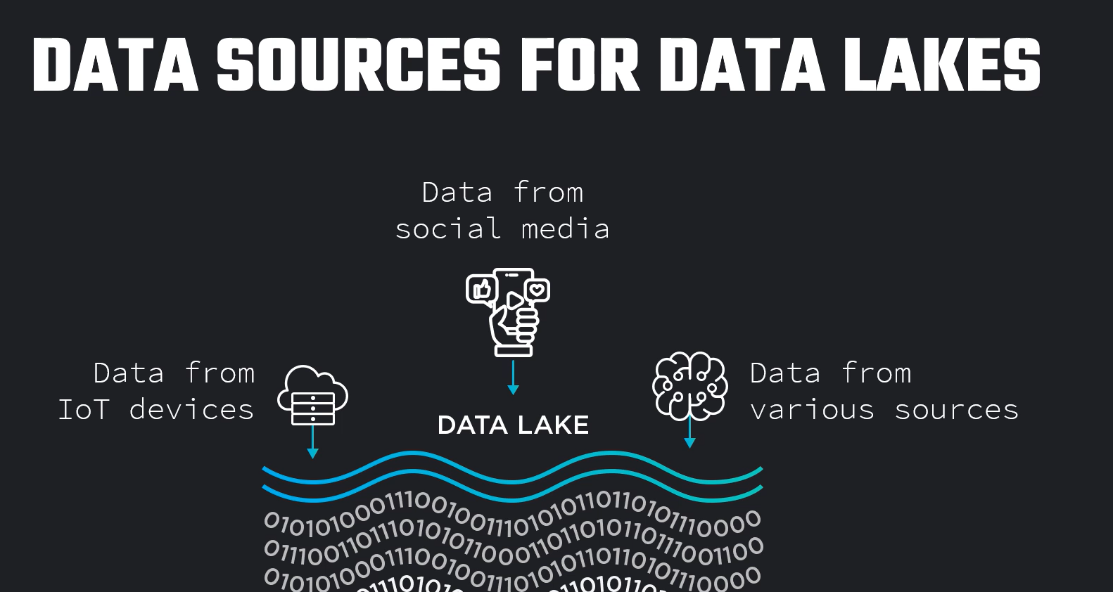
Data Sources for Data Lakes
Data from sensors
Data from other sources

Slide 7

Data Explosion Demands Flexibility
James Dixon
"Large body of water in a more natural state"

Slide 8

Comparison with Data Warehouse
Data lakes represent a paradigm shift.
Departure from the rigid structure of a data warehouse
Designed for the age of massive and diverse data.
Upcoming Lecture: Dives into the advantages of leveraging data lakes.

Slide 9
Why Use A Data Lake?

Slide 10
Evolutionary Response to Big Data
Data lakes evolved in response to the big data explosion.
Stored semi-structured, unstructured, and structured data.
Served as a flexible repository

Slide 11

Benefits of a Data Lake
They provide:
  Centralized
  Flexible
  Scalable
  Cost Effective
Solution to store and analyze huge amounts of data

Slide 12


Centralization & Accessiblity

Slide 13

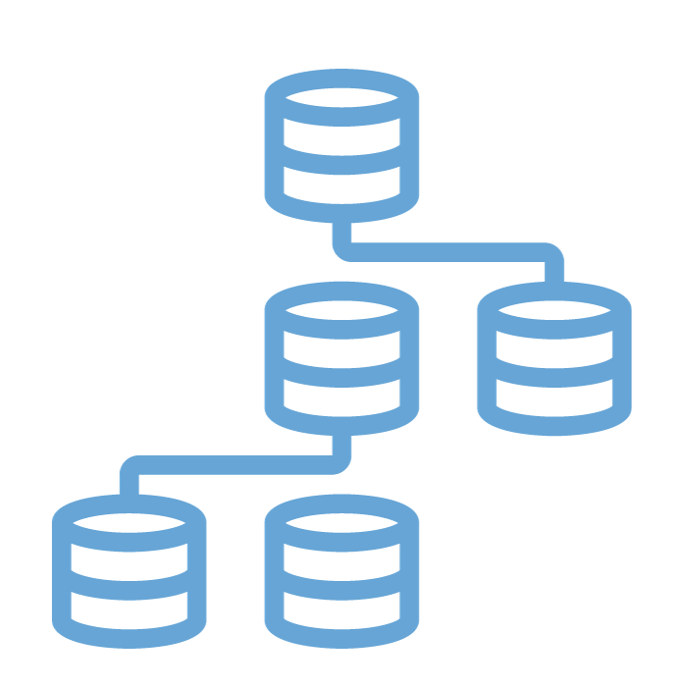
Centralization & Accessiblity
Data lake centralizes data
Democratizes data access within organizations

Slide 14


Scalability
Product Catalog
Growing Customer

Slide 15

Scalability
Data lake designed to handle petabytes of data

Slide 16


Flexibility
Diverse Data Formats
IoT devices

Slide 17


Flexibility
Diverse Data Formats
IoT devices
Data stored in its native format.
They can retrieve data make transformations on the fly
Data Engineers And Data Scientists

